Slide 1
Speech Emotion Recognition
Yashvardhan Singh Ranawat & Jishnu Moorthy

Slide 2
Motivation

Slide 3
Breakdown of Datasets
RAVDESS : Ryerson Audio-Visual Database of Emotional Speech and Song
24GB , 1440 audio files (60 trials per actor x 24 actors)
12 female and 12 male actors, Neutral North American Accent
Sentences expressed in two levels : strong, normal.
Emotions : calm, happy, sad, angry, fearful, surprise, and disgust expressions.
SAVEE : Surrey Audio-Visual Expressed Emotion
259MB
Four native English male speakers (identified as DC, JE, JK, KL) in 7 emotions
Phonetically balanced for each emotion
Emotions: anger, disgust, fear, happiness, sadness and surprise
CREMA – D : Crowd-sourced Emotional Multimodal Actors Dataset
7,442 clips of 91 actors with diverse ethnic backgrounds
African America, Asian, Caucasian, Hispanic, and Unspecified
Emotions: happy, sad, anger, fear, disgust, and neutral

Slide 4
Pre-Processing
Resampling : Standardizing the sampling rate across all audio files ensures consistency in how features are extracted and interpreted by the model.
Amplitude Normalization : Normalization helps to control the volume differences across audio files, ensuring no single file disproportionately influences the model due to volume variations.
Silence Trimming : Silence at the end or beginning doesn’t contain useful information and can be trimmed to increase computational efficiency.
Duration Handling: Trimming / Padding audio to ensure all audio files have same duration ( 3 seconds )

Slide 5
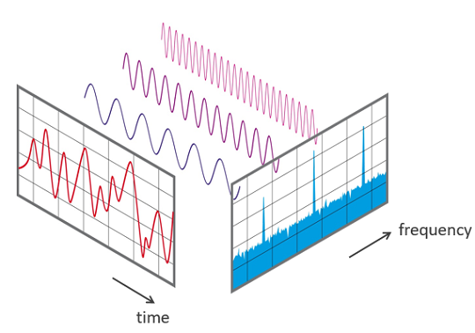
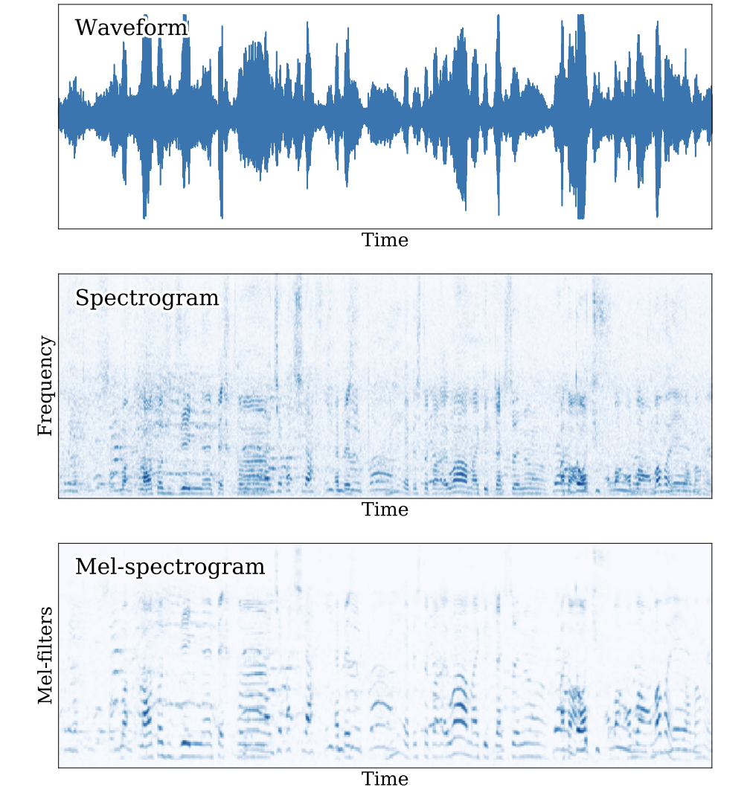
Feature Extraction
Mel-Frequency Spectrogram
Visual representation of the short-term power spectrum of a sound, based on the Mel scale
Logarithmic frequency and amplitude scales are better suited for modeling human auditory perception.
MFCC (Mel-frequency cepstral coefficients)
Set of features derived from the frequency spectrum of an audio signal, designed to mimic human auditory perception.
Usually has 12-13 features and we used 13 features.

Slide 6
Baseline Model
(Logistic Regression)
Performance
Features used - MFCCs, Zero Crossing Rate, Mel-Spectrogram
Took the mean and standard deviation of each sequence within every feature.
Standard 80/20 split of train and test of datasets
Accuracy Score: 32.6%
Insights
Using the F1 Score, Precision and Recall, we noticed that the model performed best when classifying ‘sad’ emotions and worst when classifying ‘neutral’ and ‘fear’. The overall scores suggest a poor performance and cannot be reliable in practical scenarios.
We used the mean and standard deviation as we had a sequence and had to provide an array for regression.
To improve the accuracy, we could have included additional features such as gender, age and other audio features.

Slide 7
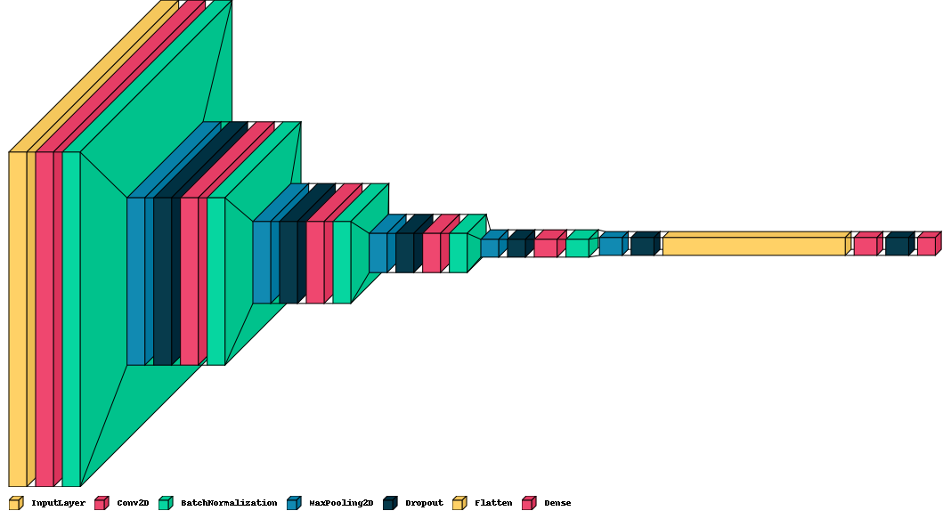
CNN Model

Slide 8
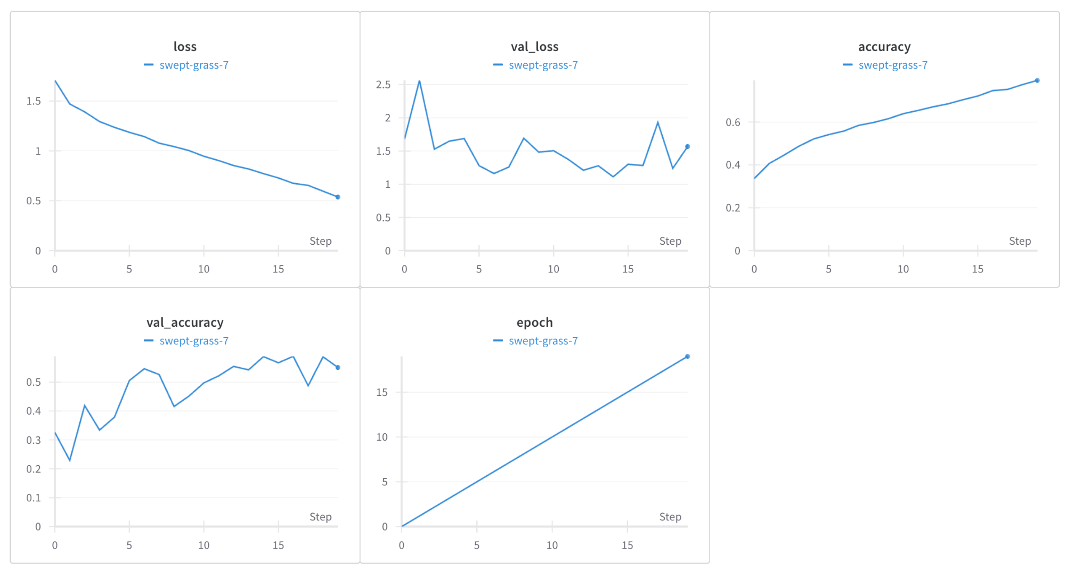
CNN Model
Performance
Features used - Mel Spectrograms
Training accuracy : ~80%
Validation Accuracy : ~55% ( State of art accuracy for RAVDESS is 80%)

Slide 9
CNN Model
Insights
The model is overfitting as validation accuracy is low and we can also see a zig-zag pattern for accuracy.
We were able to increase the accuracy from 40% to 55% by using Dropout layers.
Even without a lot of parameters, model achieves a decent result.

Slide 10
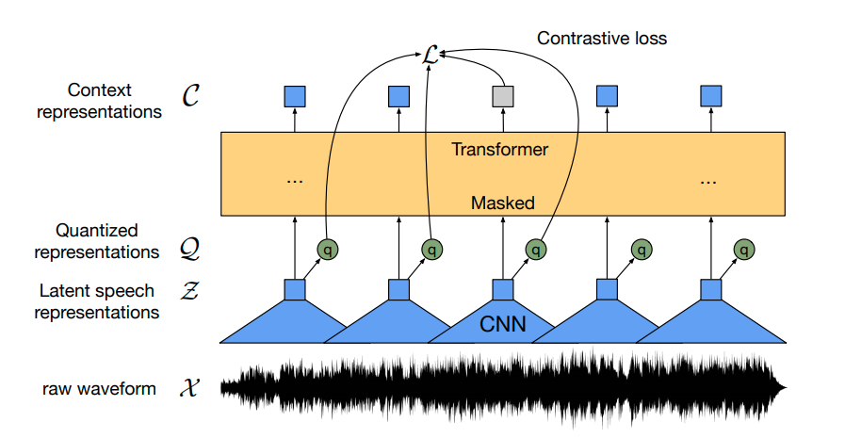
Pre Trained Transformers
Wav2Vec2

Slide 11
Pre Trained Transformers
Performance
Features used - Feature extractor provided by hugging face
Validation Accuracy : ~47% ( State of art accuracy for RAVDESS is 80%)
Insights
The model doesn’t do great because :
Absence of Emotion Labels.
Different Acoustic Features.
Variability in Expression.

Slide 12
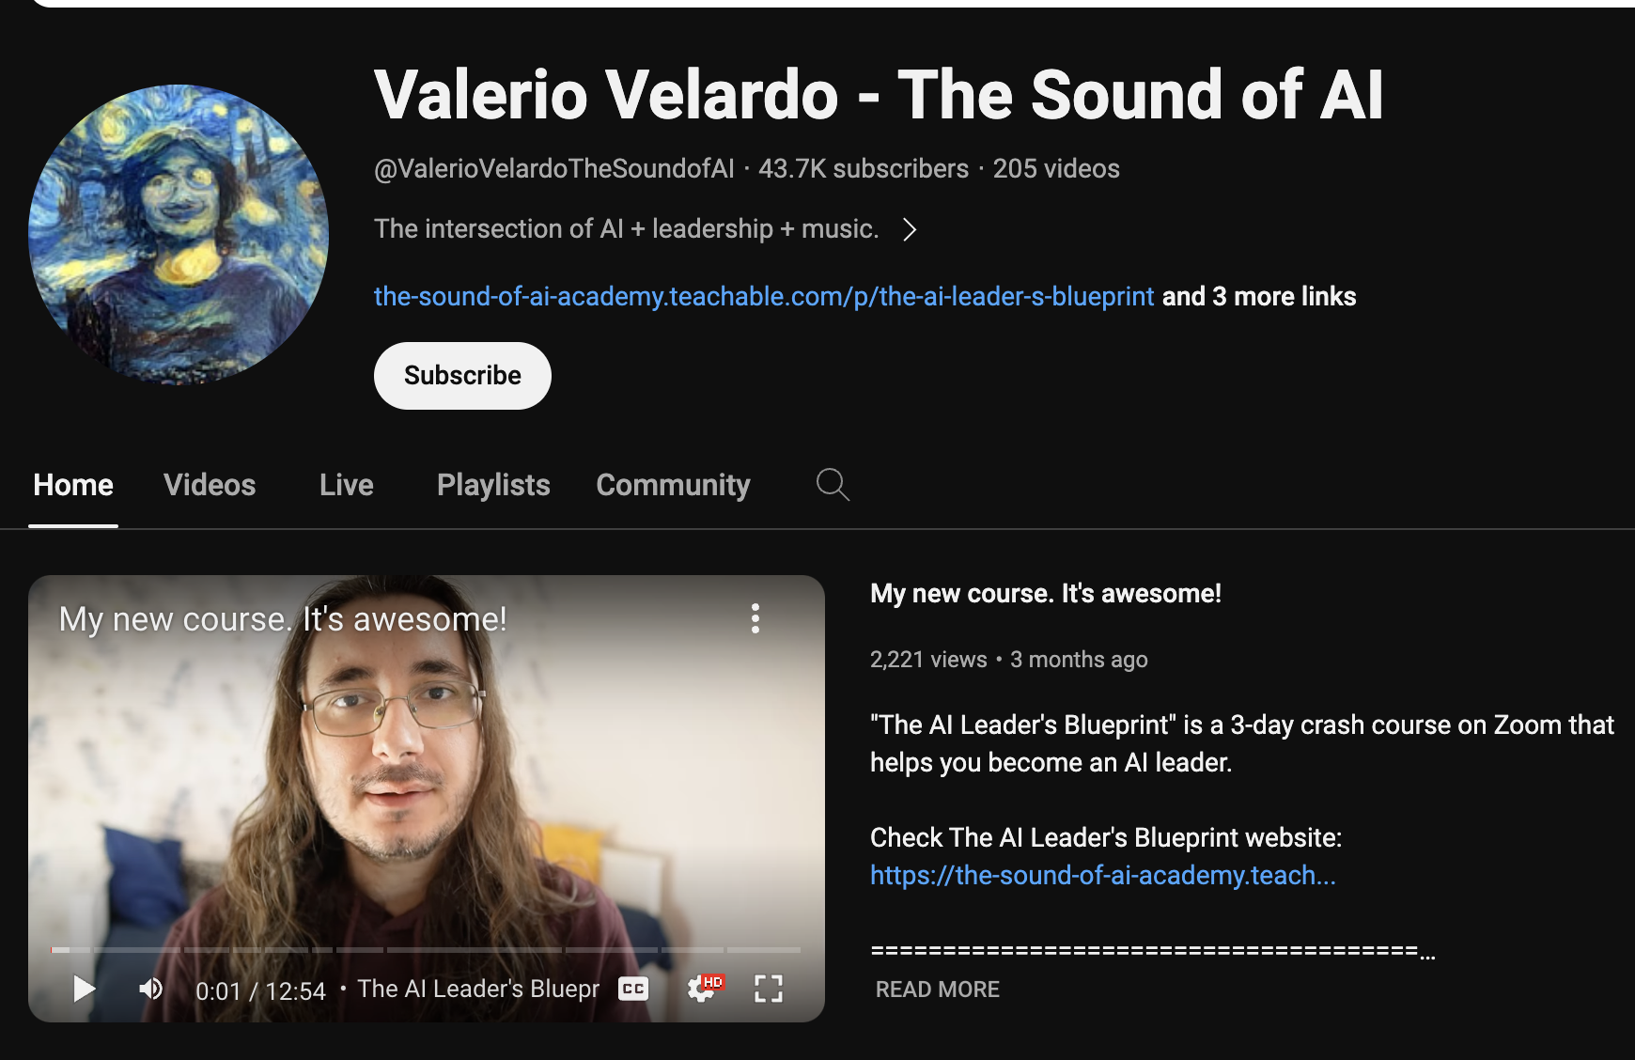
Future Work and Challenges
Future Work
Data Augmentation
Collecting more data
Using models specifically trained for this task
Deployment
Special Thanks!
Challenges
Little domain knowledge
Computationally expensive to process audio files
Combination of datasets

